Slide 1
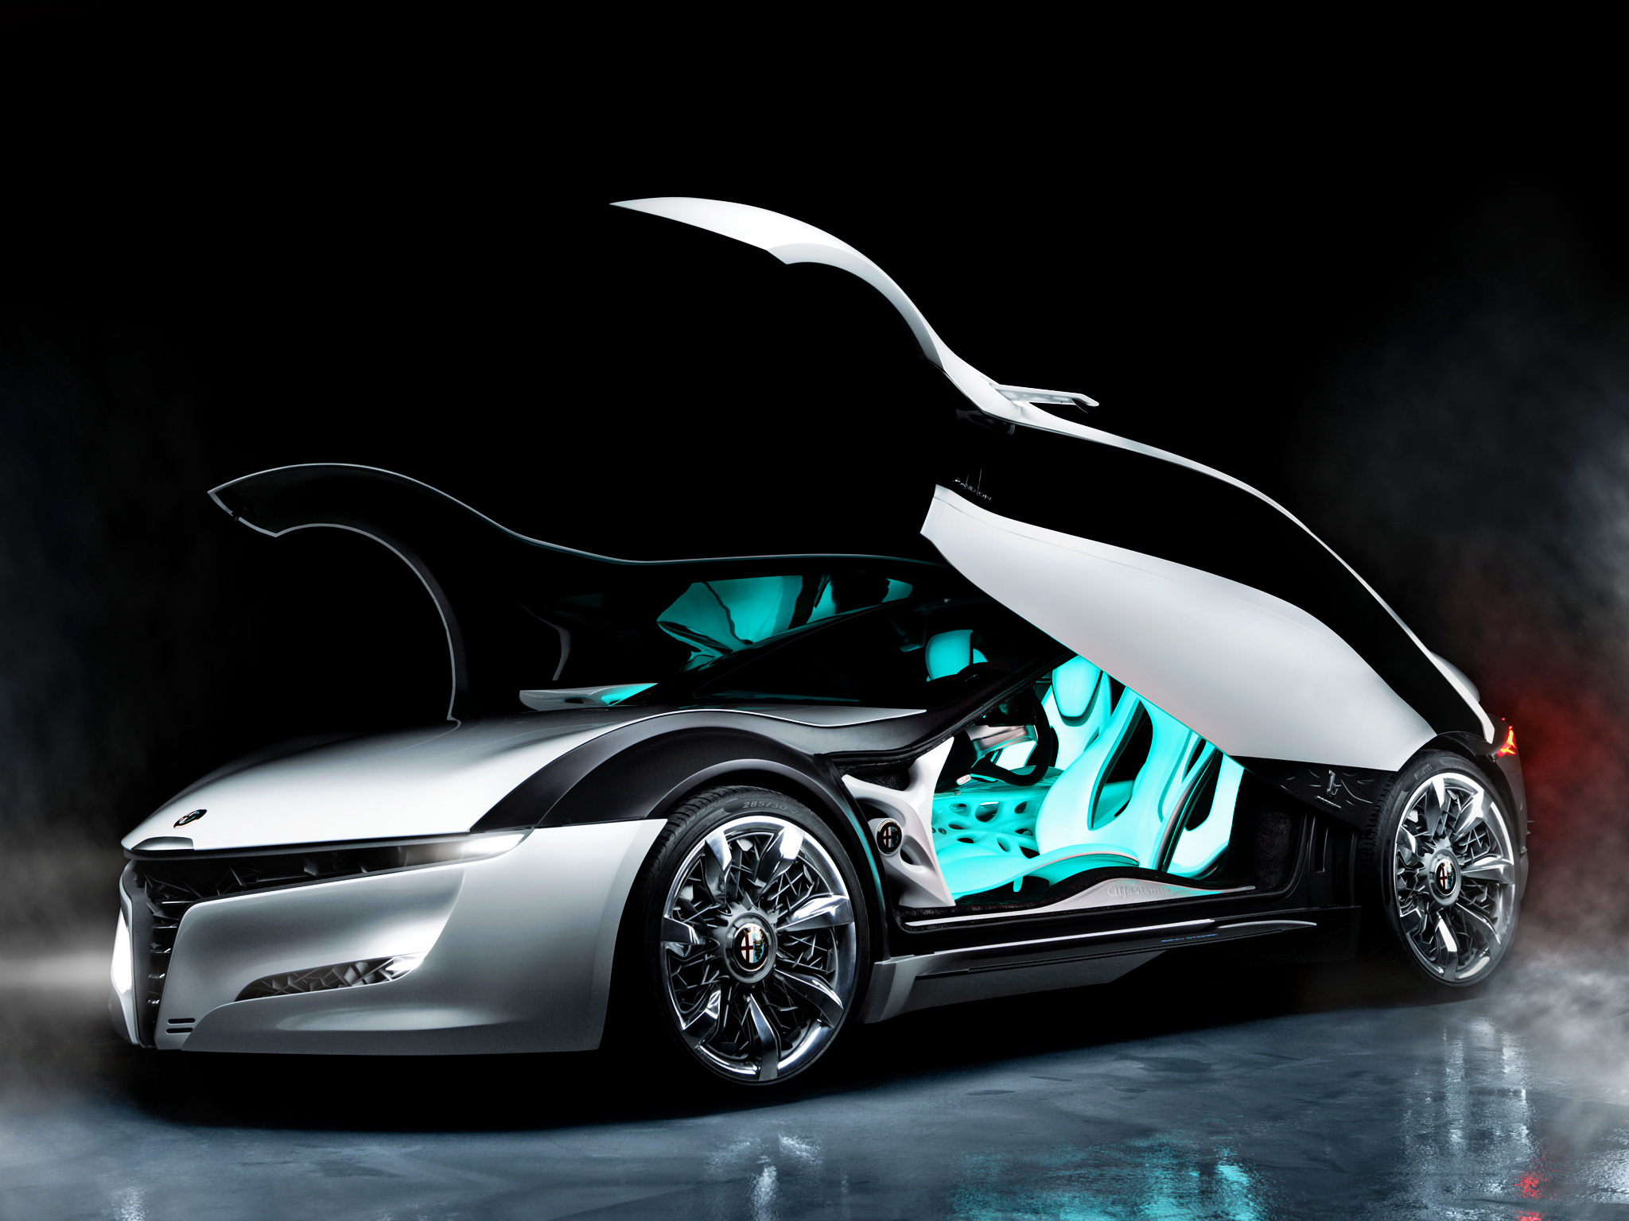
Autonomous Car
Apostolopoulos Theodoros
Dialektakis George
Embedded Microprocessors Systems(ΗΡΥ441)

Slide 2
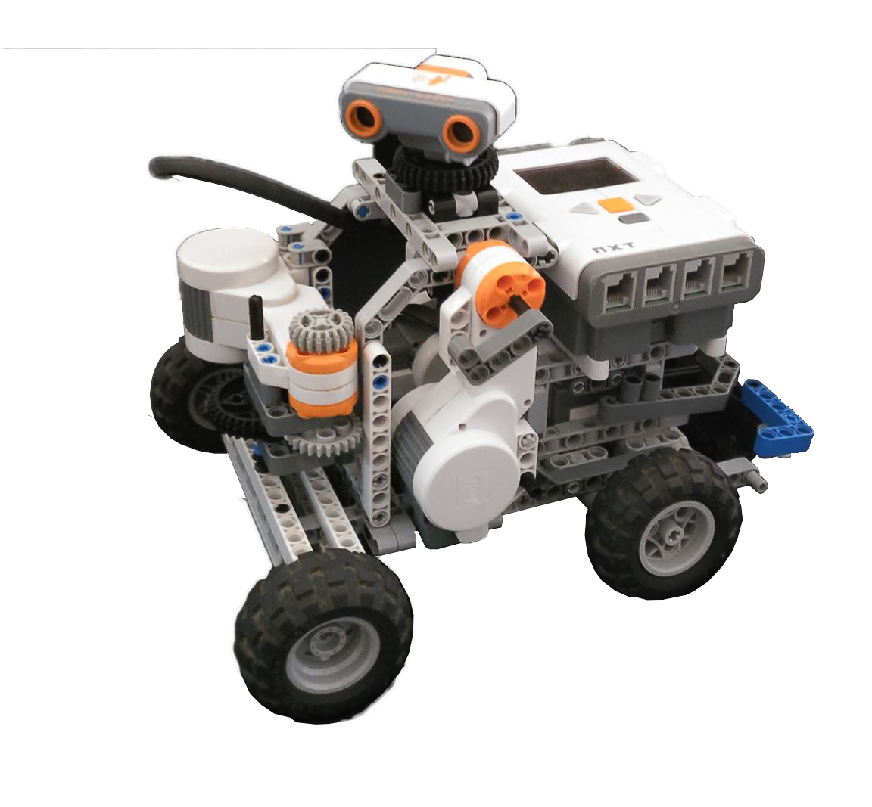
The project
Build a versatile vehicle
NXT Lego Mindstorms Technology
Abilities:
Move around space
Avoid obstacles
Automatic parking system

Slide 3
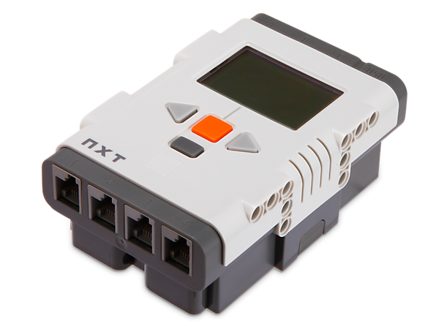
The technology(main unit)
NXT Brick:
32-bit ARM microcontroller
8-bit AVR microcontroller
256 KB of FLASH memory and 64 KB of RAM
Bluetooth support
Power is supplied by 6 AA (1.5V each) batteries
Notes:
The main component in the kit is a brick-shaped computer called the NXT Intelligent Brick AKA(Ciara). It can take input from up to four sensors and control up to three motors, via cables similar to but incompatible with phone cords.
It has a 32-bit ARM7TDMI-core Atmel AT91SAM7S256 microcontroller with 256 KB of FLASH memory and 64 KB of RAM, plus an 8-bit Atmel AVR ATmega48 microcontroller, and Bluetooth support.
Input method: HARD POLLING

Slide 4
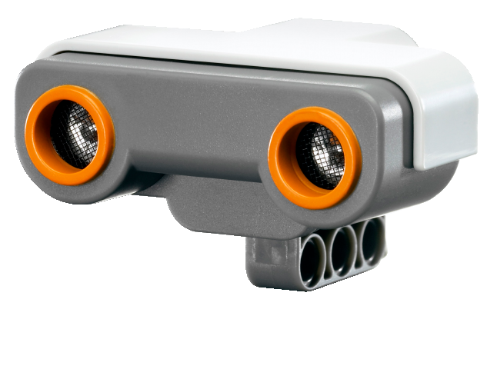
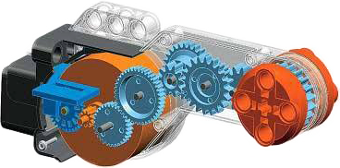
The robot
Sensors:
Ultrasonic sensor
Measures distance within range from 0 to 253cm with 3cm precision.
Detects objects and movement in a straight line in front of it.
Motors:
Movement motor
Sensor rotation motor
Wheels rotation motor
Have build-in internal rotary encoders of one-degree accuracy
Notes:
3 identical servo motors that have built-in reduction gear assemblies with internal optical rotary encoders that sense their rotations within one degree of accuracy
The ultrasonic sensor can measure the distance from the sensor to something that it is facing, and detect movement. It can show the distance in both centimeters and inches. The maximum distance it can measure is 233 cm with a precision of 3 centimeters. The ultrasonic sensor works by sending out ultrasonic sound waves that bounce off an object ahead of it and then back. It senses the time it took for that to happen.
Hard polling

Slide 5
Programming environment
We used RobotC instead of the original platform
RobotC:
C-based programming language
Includes special instruction sets to control the peripherals
Allows on-screen depiction of sensor values
Gives access to multiple small sample projects

Slide 6
Software
Benefited from the characteristics of Structured Programming
Main functions refer mostly to handling Motors
Most significant functions:
writeDebugStreamLine()
MotorEncoder() – MotorEncoderTarget()
Guide()
Check()
Most important problem: time administration inside the code

Slide 7
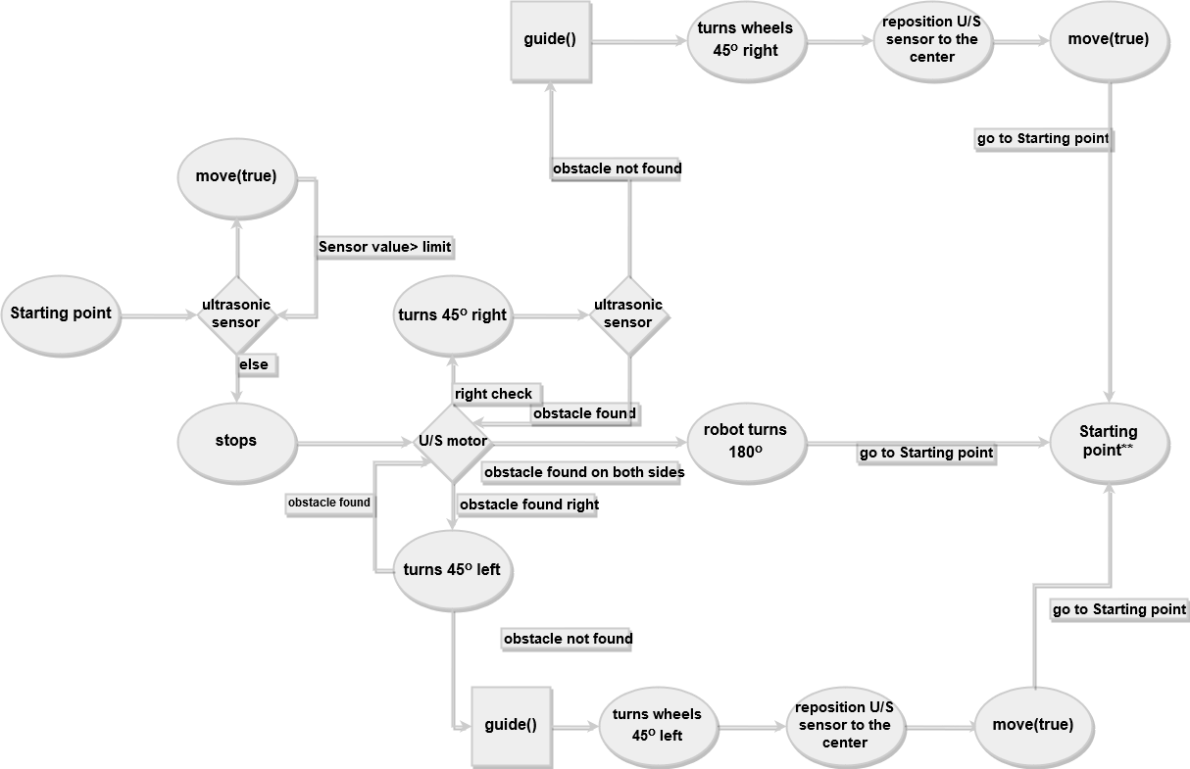
Autonomous movement
Notes:
move(true) = forwards

Slide 8
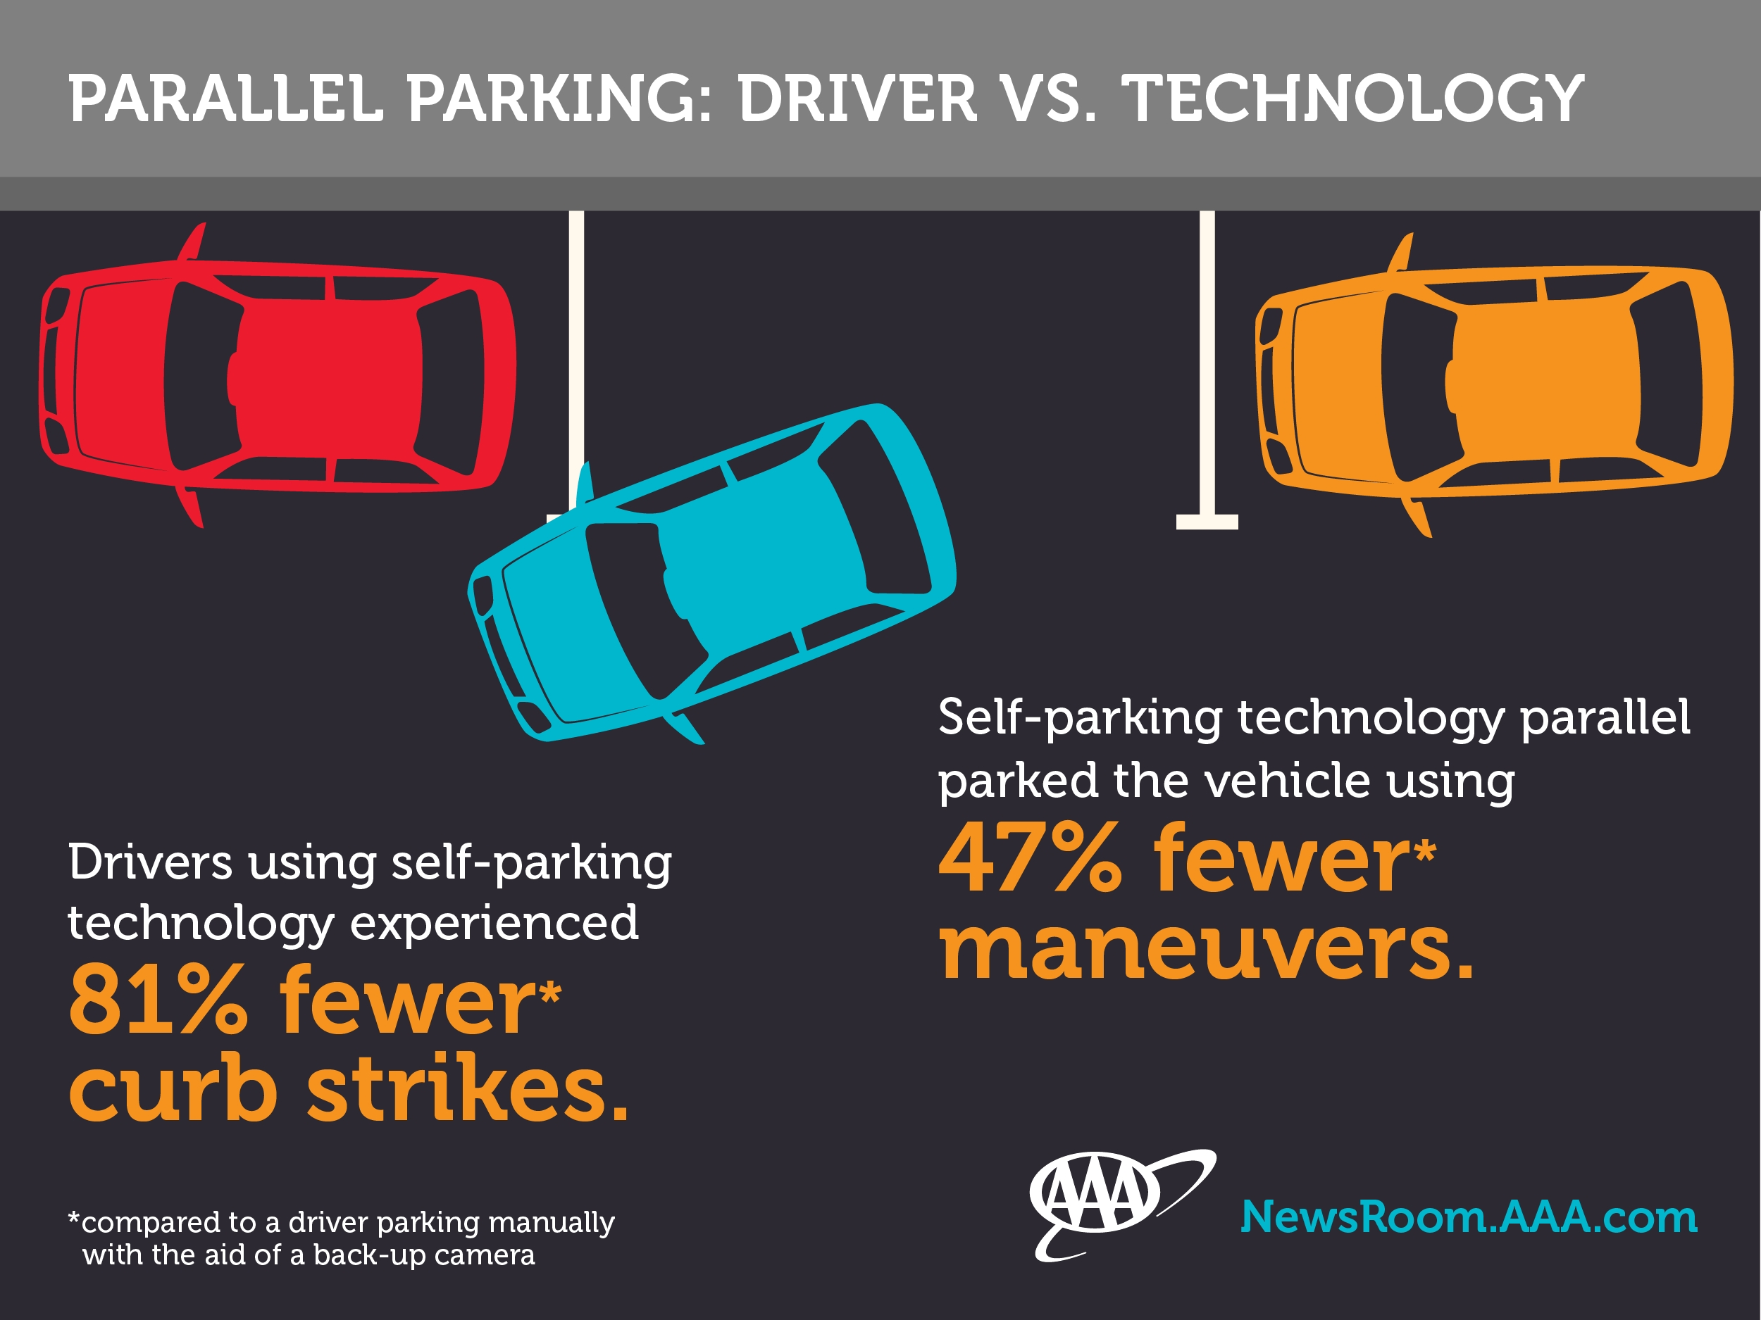
Happening right now…
Second milestone: free movement in space
Unlocks potential of exploiting these functions for every other movement
Allows us to work on automatic parallel parking

Slide 9
Thank you for your attention Good luck to all of you!

